Slide 1


Success in the Arts Film & Theater Awards Partnership Proposal
Produced by Dara Bragg in Association with Success in the Arts Seminars

Slide 2
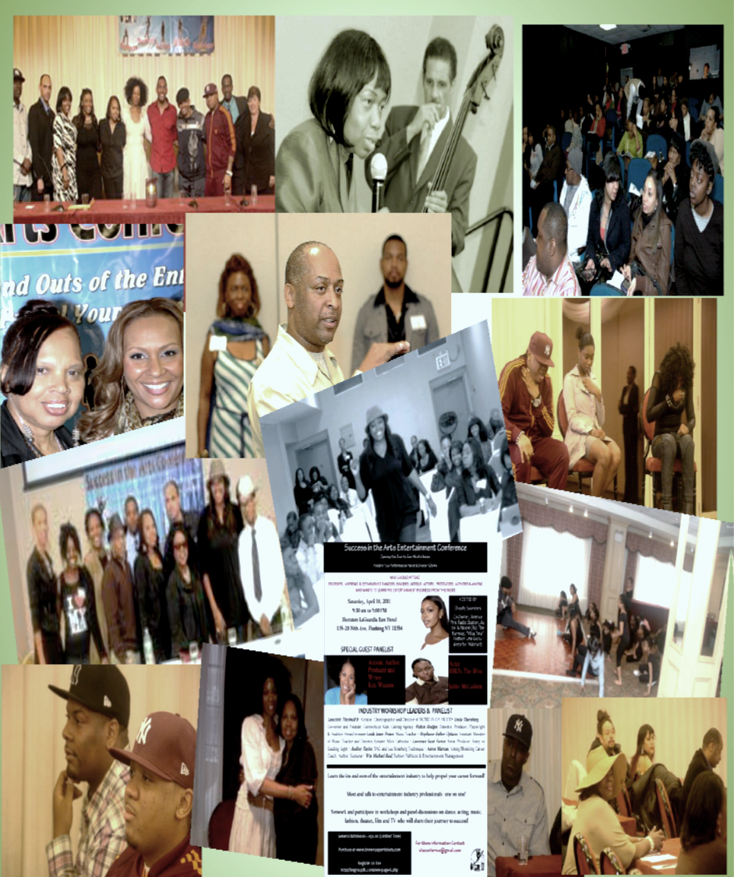
For thirteen years, Success in the Arts has become the go to place for aspiring artists to learn in detail the ins and outs of the entertainment industry.
Dara Bragg has provided opportunities for artists to interact, ask questions and network with successful artists and take away knowledge they did not get from a classroom. In keeping with herself proclaimed mandate to inspire new artists, Dara’s vision of an award show is now a reality and is asking for you to partner with her to further show NYC film makers, playwrights, screenwriters and directors that they can achieve their dreams and the entire city supports them.
Success in the Arts Film and Theater Awards is another venue and avenue for these impressionable but determined visionaries to showcase what they are most proud of.
And as a sponsor of the Awards, we will showcase what you are most proud of. As partners, we share in the success of a new artists. Past partners in support of local artists have included but not limited to successful born and bread or current residents of NYC entertainers just like yourself. They took a chance on themselves with a little help from others.
We ask you to take this empowering journey with these artists and at the same time let us support you in your journey.
Partners of Success in the Arts include but not limited to: Kim Wayans, actress, (In Living Color, Scary Movie 2, I’m Gonna Git You Sucka, Low Down Dirty Shame, and Juwanna Mann and In the House), author, writer and producer • HBO’s The Wire’s Julito McCullum • Chasity Saunders, entrepreneur & model (Rip the Runway, "Miss Tina" Fashion Line Exclusively for Walmart) • Aaron Marcus, acting/modeling/career coach & author • Conrad Dimanche, Bad Boy Entertainment/PMP Worldwide • William Michael Reid, fashion publicist & manager • Lawrence Saint Victor, actor, (Guiding Light) • Lancelot Theobald Jr, choreographer and director of MOMZ-N-DA HOOD • Fulton Hodges, director, producer, playwright • Wendy McKenzie casting director (Notorious, Secret Life of Bees, The Blindside) • Fulton Hodges, director, & playwright • Jermaine Vanderhorst, filmmaker • Kiki Haynes, actress, Tyler Perry’s For Better or Worse, Bamboozled, Shaft, Brown Sugar, Double Duty, As the World turns, Rules of Engagement and Strong Medicine • Kel Spencer, recording artist, songwriter (Will Smith, Nick Cannon) • Beverly Orozco, director, producer of the feature Film Getting Even • Dawnyelle Butler, director & CEO, Dawn Productions

Slide 3

What exactly is the Success in the Arts Film and Theater Awards?
Glad you asked, shows you are interested!!!!!
Success in the Arts Film and Theater Awards recognizes New York City’s rising stars of Indy Films, One Act Plays, Web Originals & Series, Screenwriting, Playwrighting and Directing in the genres of Short Story, Dramedy, Comedy, Drama, Romance, Animation, Music video and Documentary.
Content will be judged by a panel of entertainment industry professional. The show is open to the public and the artists family and friends.
Why now and why an award show?... Also a good question!
Why not now. Why not take every opportunity we have to support each other. Why not create spaces utilize venues and share ideas. We decided to manifest the Academy Awards and Tony Awards our reality until we get them there because if we don’t who will? This particular award show is focused on the creativity and talent of the artist. Our intent is not to gauge hundreds or thousands of dollars from the artist (entry fee is $20) and thereby fostering trust between the artist and the local grassroots entertainment industry.
Dara Bragg decided to produce an awards show rather than a film festival for several reasons:
Keep the cost down for production
Keep the competition intimate and focused on the entries
Celebrate the work and dedication of each artists individually
Have an expanded array of genres and vehicles
We currently have several inquires and a few submission before we have officially started the marketing or solicitation, so that shows us that there is a need and a want for this event.

Slide 4

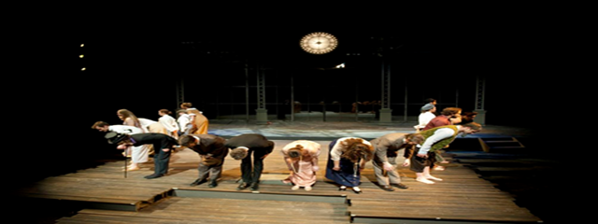

We want to make your partnership an opportune to really interact with your target audience. We invite you think outside the traditional sponsor box and consider making the event work for you. Customize how you want to share your support and what works for you!
Best Film, Best Play, Best Webseries Presented by you. Your choice, and every time we say the award we say your name. Every place the award is printed will have your name!!!!
Showcase your latest product or service with a pre-event Happy Hour or lunch with the artists, judges and invited guests
Want your brand logo in the hands of EVERY participant and attendee? Sponsor the Audience Award by providing raffle prizes and brand the ticket with your company name or logo
Your Company Name Here
Get up and Go Sponsor: Provide Uber or LYFT rides for our panel of judges to and from the Award Ceremony venue

Slide 5
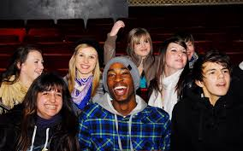

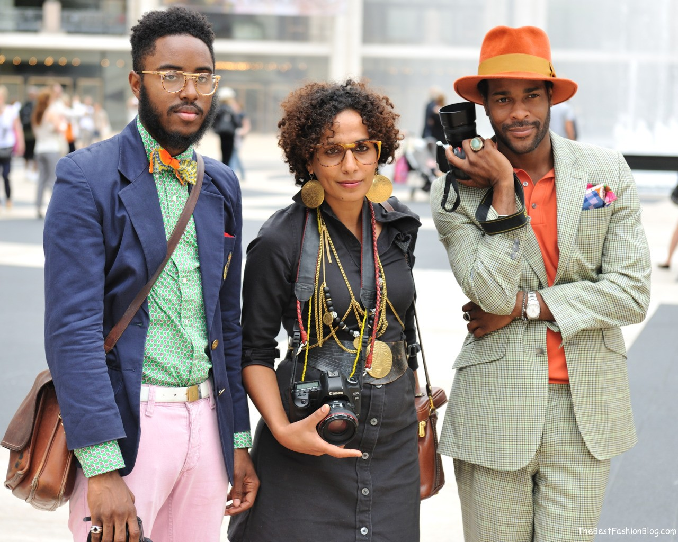

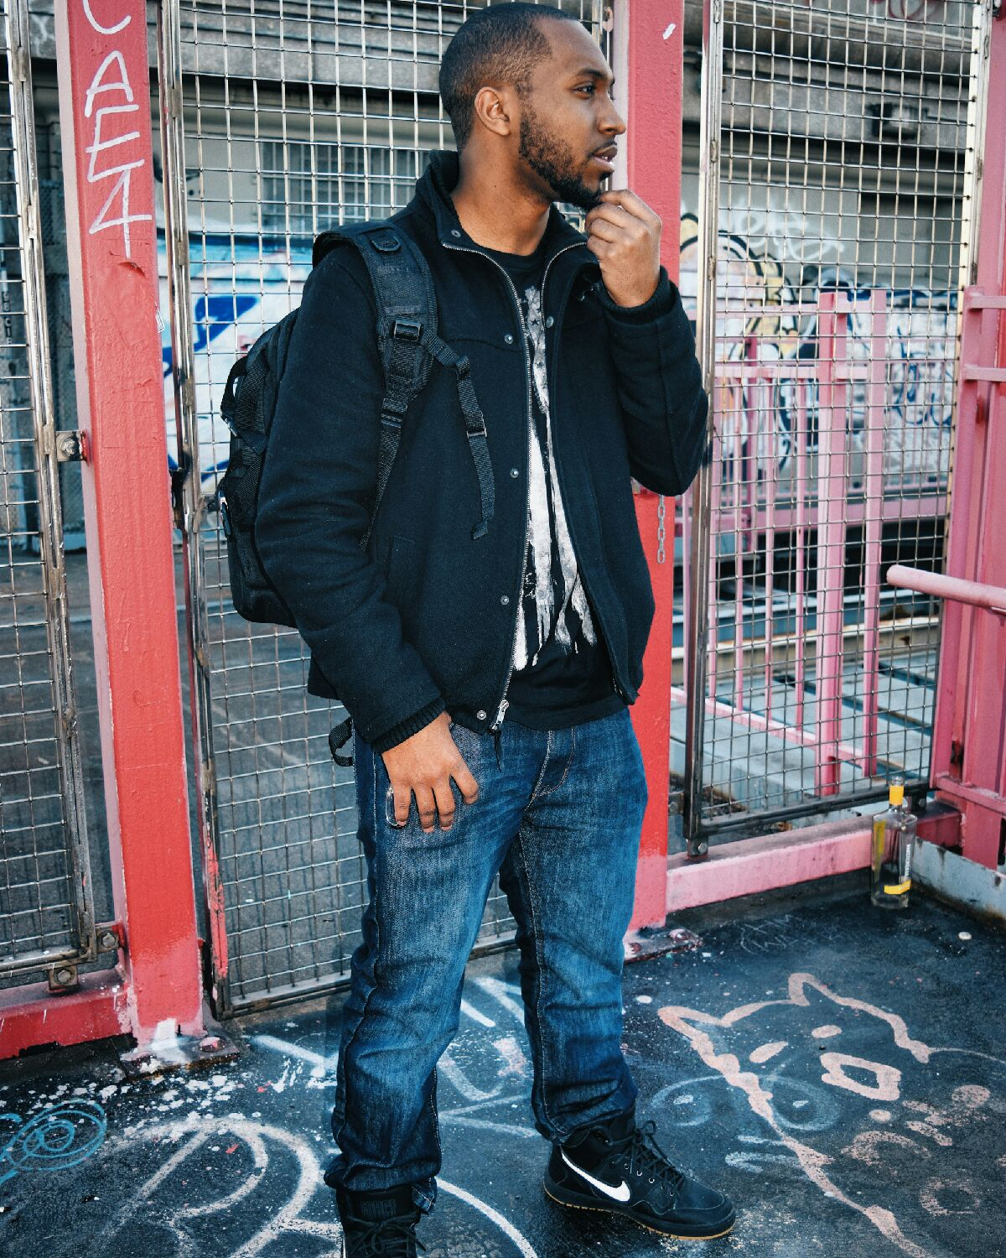
Geographical Region
85% NYC Five Boroughs
15% Long Island, NY, Upstate NY & New Jersey
Ages
Millennials – 70%
Gen X – 25%
Baby Boomers 5%
Economic Background
$25K to $40K – 50%
40K to 60K – 40%
60K to 75K - $10%
Did you know…Millennials spend a lot more on "experiences" — things like travel, entertainment, and dining. (.businessinsider.com)

Slide 6

Partner Sponsorship
Headline $5,000
Director $2,500
BENEFITS:
Full Page ad in commemorative program
1-2 Exhibitor/Vendor Booths
Opportunity to distribute promotional items at Award Ceremony and swag bags
4 all-access Guest passes
name/logo included on all Promotional Material
On stage remarks & Recognition
Posting on Social Media
BENEFITS
Half Page ad in commemorative program
2 All Access Guest Passes
1 Exhibitor/Vendor Booth
2 all-access Guest passes
name/logo included on all Promotional Material
On stage recognition
Friend of the Arts $500
Acknowledgement in Commemorative Program
1 Vendor Booth
1 VIP Ticket
Logo included on select promotional material
Onstage Recognition
Producer $1,000
½ page ad in the commemorative program
1 Vendor Booth
Logo on promotional material
2 VIP tickets
Logo included on select promotional material
Onstage Recognition

Slide 7
With your support and encouragement, we can reach even more artists as they reach for their dreams.
Thank you for your time and we look forward to partnering with you. If you have any questions, please feel free to contact me Tyriq Mustaqiym at successinthearts2@yahoo.com
The SITA TEAM and the Aspiring Artists we serve

